Slide 1
Image Segmentation using Graph Cuts and Constraint Clustering
👩‍💻 By:
Ariba M Saleem [B2331022]
Ayesha Awan [B2331027]
Daniyal hanif [B2331034]

Slide 2
Introduction to Image Segmentation
What is Image Segmentation?
It’s a process where we divide an image into meaningful parts or segments.
Think of it like coloring each object or region in the image differently so a computer can “see” distinct areas.
Why do we do it?
Makes analyzing images easier.
Helps computers understand the contents of an image, such as detecting objects, tumors, roads, or faces.
Applications:
Medical Imaging: Highlighting organs or tumors.
Object Detection: Detecting cars, people, animals in photos or videos.
Computer Vision: Used in robotics, autonomous cars, photo editing, etc.
What this project does:
Compares Graph Cuts (GrabCut) vs Constraint Clustering (K-Means using LAB+XY features).
Basically, two ways to segment images and see which works better in different scenarios

Slide 3
•Image is Loaded The program first reads the input image.Example: cv2.imread("image.jpg")
•Initial Bounding Box / Mask A rough rectangle is drawn around the object.This rectangle tells the algorithm where the foreground might be.
•Graph is Created Each pixel becomes a “node” in a graph.The algorithm checks how similar or different pixels are (color, texture, edges).
•Grab Cut Algorithm Runscode example:cv2.grabCut(image, mask, rect, bgmodel, fgmodel, iterations, mode)It separates likely foreground pixels from background pixels After each iteration, the result becomes cleaner.
Final Output
•The background is removed
•only the clear foreground object remain

Slide 4
Why Constraints Are Needed
Without constraints, segmentation can be noisy or inaccurate.
Constraints guide the algorithm to produce more realistic and consistent regions.
They improve model performance and prevent overfitting.
Types of Constraints
Spatial Constraints: Maintain neighborhood relationships between pixels.
Shape Constraints: Preserve geometric structure of objects.
Topological Constraints: Keep connected components intact.

Slide 5
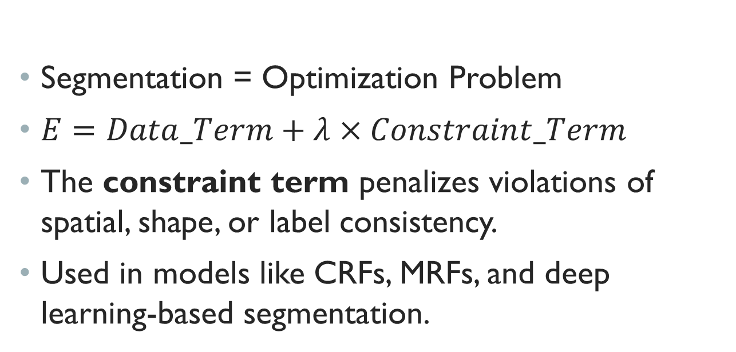
Mathematical View of Constraints
Segmentation = Optimization Problem
$E=Data_Term+λ×Constraint_Term$
The constraint term penalizes violations of spatial, shape, or label consistency.
Used in models like CRFs, MRFs, and deep learning-based segmentation.

Slide 6
Deep Learning + Constraints
CNNs or Transformers (like BERT for vision) handle feature learning.
CSP (Constraint Satisfaction Problem) adds logical consistency.
BERT + CSP Constraints: combine semantic understanding with spatial logic.

Slide 7
Errors, Fixes & Conclusion:
Errors, Fixes, and Final Thoughts
Common Errors (During Implementation)
Over-segmentation: The model divided regions too finely when colors were similar
Weak Boundaries: Foreground and background overlapped at object edges
Fixes Used :
Applied morphological operations to remove extra small noisy segments
Used iterative GrabCut refinement to clearly separate object boundaries
Adjusted cluster values dynamically for better K-Means results.

Slide 8
Results on BSDS Dataset Model
Pixel Accuracy IoU Score GrabCut 92.5% 83.7%
K-Means 85.4% 72.1%
Conclusion: GrabCut performed best overall with 92% accuracy and better IoU, meaning more accurate region detection.

